Slide 1
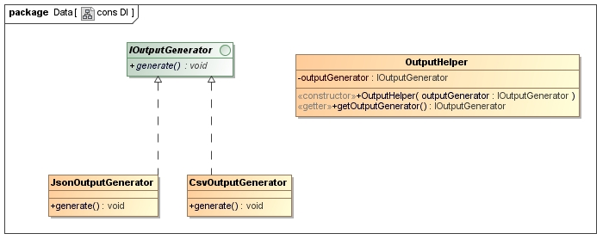
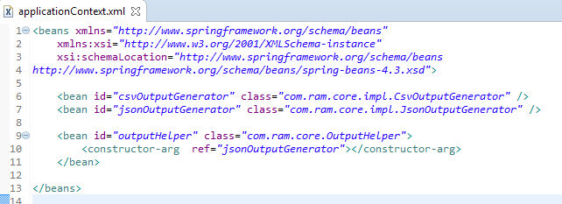
Constructor Injection
This DI method will injects the dependency via a constructor.
A bean configuration file to declare the beans and set the dependency via constructor injection (constructor-arg tag).
You just injects a ‘jsonOutputGenerator’ bean into ‘outputHelper’ object via a constructor.

Slide 2
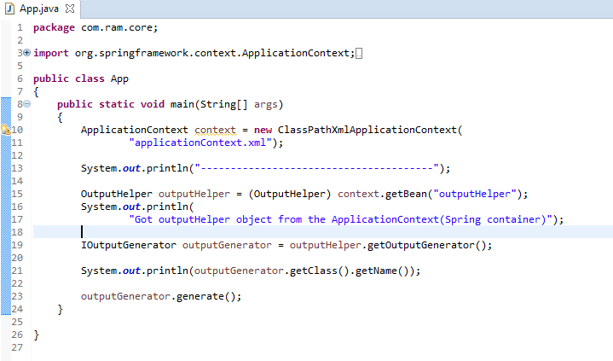
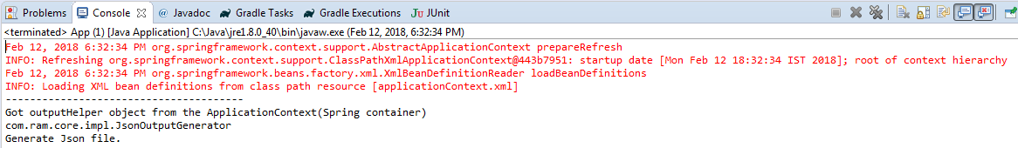
Constructor Injection

